Slide 1
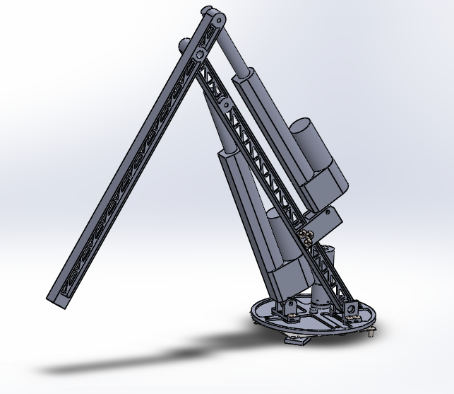

Arm Design
Arm lengths based on 2-D sketches
-Rover Dimensions and task specifications accounted for
End plate allows for multiple tools to be attached for the different tasks
Spherical coordinates used over Cartesian to make the arm more moveable
-Most NASA rovers implement as “free-range motion”

Slide 2
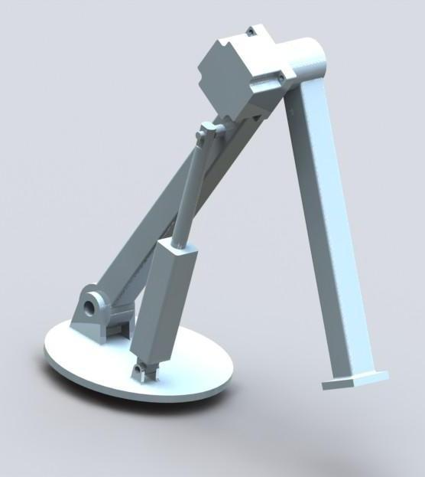
Arm then…
Basic CAD model done
No actual fabrication
Rules for competition were not available, so dimensions were arbitrary

Slide 3
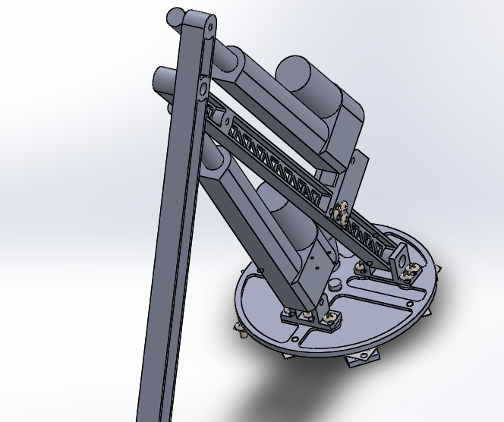
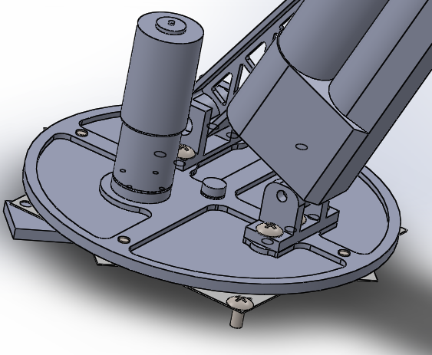
Arm now
Aluminum body
Mounted to rotary plate with 360° range
Linear movements controlled by two linear actuators
- 200 lbs of force each
- Rapid feed rate
- Extend approximately 6”
- Approx. 90° vertical range
- Approx. 170°of motion at elbow joint
- Arm joint controlled by linear ...actuator
Currently on the fabrication process
-All parts are being machined

